Slide 1

Membangun Infrastruktur Berbasis Container Orchestration
Small Project 3

Slide 2
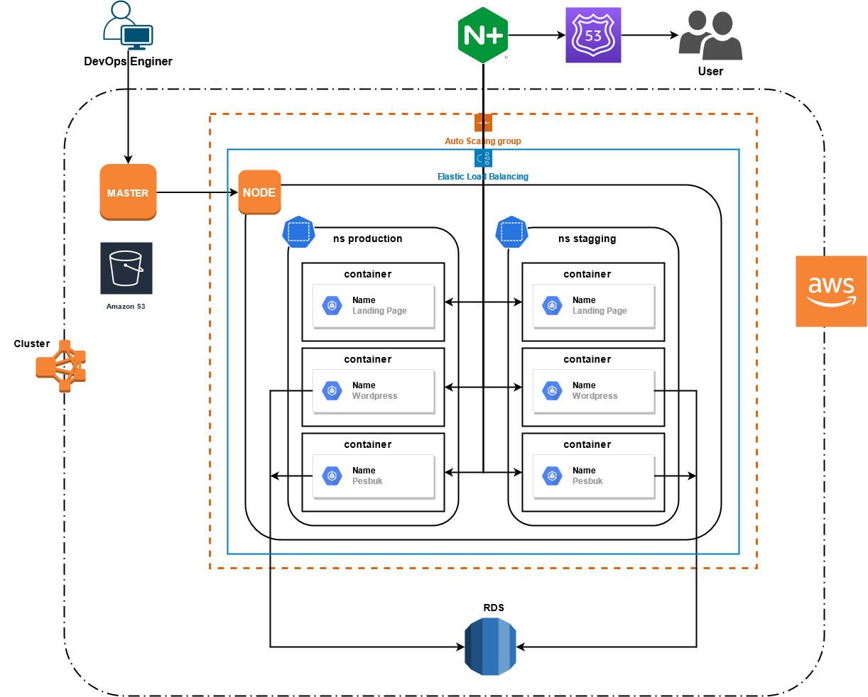
Topologi

Slide 3
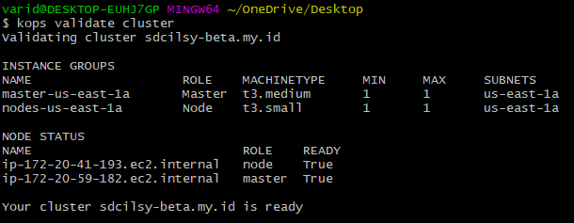
Cluster info

Slide 4
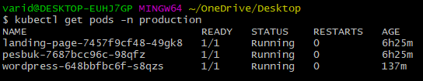
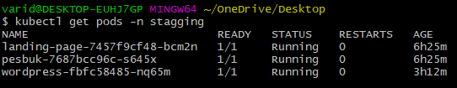
Pods info

Slide 5


Service info

Slide 6
Persistent Volume Claim info

Slide 7


Secret file info

Slide 8
Ingress info

Slide 9
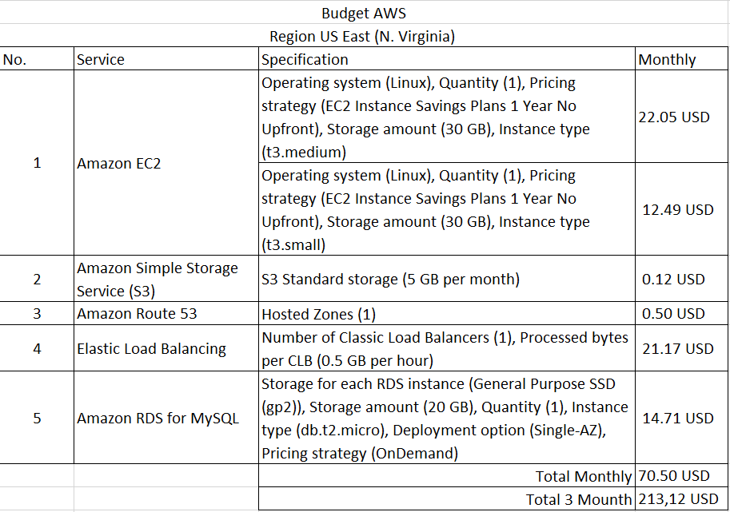
Biaya AWS

